Slide 1
Foundations of Cryptography PRG, fixed-length encryption from PRG, one-way function, PRG with arbitrary expansion, stream cipher
LiangFeng Zhang
zhanglf@shanghaitech.edu.cn
SIST, ShanghaiTech, 2019F

Slide 2
Pseudorandom Generator (PRG)
DEFINITION: A function $G:{\left\{0,1\right\}}^{n}→{\left\{0,1\right\}}^{l(n)}$ is called a pseudorandom
generator (PRG) if it satisfies the following conditions:
efficiently computable: there is a deterministic polynomial-time algorithm $D$ such that $D\left(x\right)=G(x)$ for all $x∈{\left\{0,1\right\}}^{n}$
expansion: $l\left(n\right)>n$ for all $n∈ℕ$
$l$is called the expansion factor of $G$
pseudorandomness: $G(U_{n})$ is pseudorandom, where $U_{n}$ is uniformly distributed over ${\left\{0,1\right\}}^{n}$
$∀$ PPT algorithm $𝒟$, $∃$ a negligible function $negl(⋅)$ s.t.
$|Pr⁡[𝒟\left(G\left(U_{n}\right)\right)=1]−Pr⁡[𝒟\left(U_{l(n)}\right)=1]|≤negl(n)$

Slide 3
Understanding PRG
REMARK: The output distribution of a PRG looks uniform.
EXAMPLE: The function $G:{\left\{0,1\right\}}^{n}→{\left\{0,1\right\}}^{n+1}$ defined by
$G\left(s_{1}s_{2}⋯s_{n}\right)=s_{1}s_{2}⋯s_{n}(⊕_{i}s_{i})$
is not a PRG.
Design a PPT algorithm $𝒟$ to distinguish between $G(U_{n})$ and $U_{n+1}$
INPUT: $x∈{\left\{0,1\right\}}^{n+1}$ // $x←G(U_{n})$ or $x←U_{n+1}$
Output $1$ if $x_{n+1}=⊕_{i=1}^{n}x_{i}$; otherwise, output $0$.
Analysis:
$Pr\left[𝒟\left(G(U_{n})\right)=1\right]=\underset{x←G(U_{n})}{Pr}\left[𝒟\left(x\right)=1\right]=1$
$Pr\left[𝒟\left(U_{n+1}\right)=1\right]=\underset{x←U_{n+1}}{Pr}\left[𝒟\left(x\right)=1\right]=\underset{x←U_{n+1}}{Pr}\left[x_{n+1}=⊕_{i=1}^{n}x_{i}\right]=\frac{1}{2}$
$|\operatorname{Pr}\left[𝒟\left(G\left(U_{n}\right)\right)=1\right]−Pr⁡[𝒟\left(U_{n+1}\right)=1]|=\frac{1}{2}$, non-negligible
$\{G\left(U_{n}\right)\}$ is not pseudorandom
$G$ is not a PRG

Slide 4
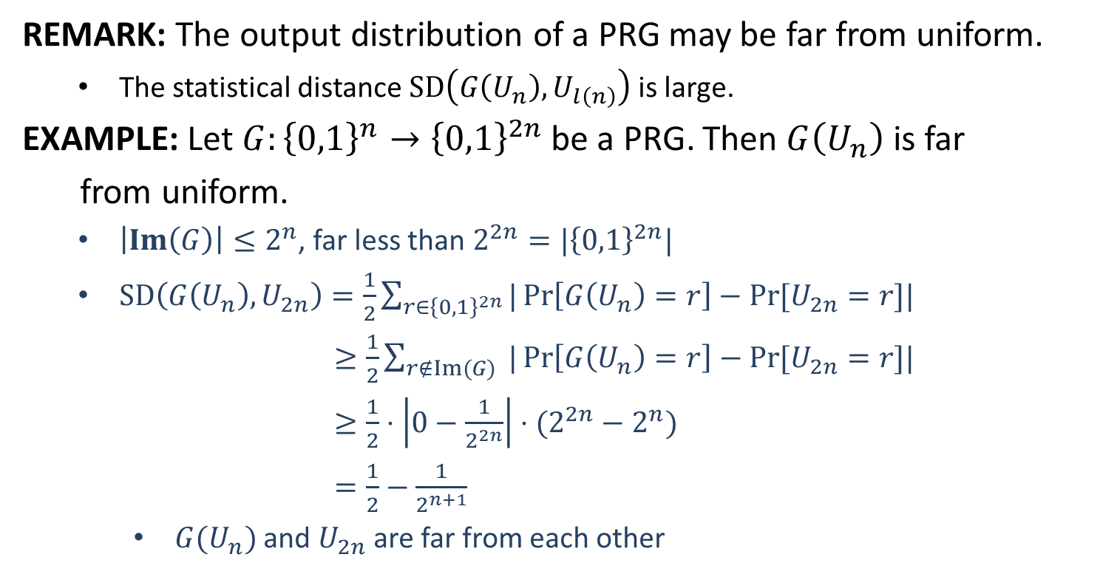
Understanding PRG
REMARK: The output distribution of a PRG may be far from uniform.
The statistical distance $SD\left(G\left(U_{n}\right), U_{l\left(n\right)}\right)$ is large.
EXAMPLE: Let $G:{\left\{0,1\right\}}^{n}→{\left\{0,1\right\}}^{2n}$be a PRG. Then $G\left(U_{n}\right)$ is far
from uniform.
$\left|Im\left(G\right)\right|≤2^{n}$, far less than $2^{2n}=|{\left\{0,1\right\}}^{2n}|$
$SD\left(G\left(U_{n}\right), U_{2n}\right)=\frac{1}{2}\sum_{r∈{\left\{0,1\right\}}^{2n}}{|\operatorname{Pr}\left[G\left(U_{n}\right)=r\right]−Pr⁡[U_{2n}=r]|}$
$≥\frac{1}{2}\sum_{r∉Im(G)}{ |\operatorname{Pr}\left[G\left(U_{n}\right)=r\right]−Pr⁡[U_{2n}=r]|}$
$≥\frac{1}{2}⋅\left|0−\frac{1}{2^{2n}}\right|⋅(2^{2n}−2^{n})$
$=\frac{1}{2}−\frac{1}{2^{n+1}}$
$G(U_{n})$ and $U_{2n}$ are far from each other

Slide 5
Understanding PRG
REMARK: Breaking PRG is trivial given unlimited computational power
EXAMPLE: Let $G:{\left\{0,1\right\}}^{n}→{\left\{0,1\right\}}^{2n}$be a PRG. Distinguish between
$G(U_{n})$ and $U_{2n}$ with unlimited computational power.
The distinguisher $𝒟$:
INPUT: $x∈{\left\{0,1\right\}}^{2n}, x←G(U_{n})$ or $x←U_{2n}$
$For$ $s∈{\left\{0,1\right\}}^{n}$ $do$
$If$ $G\left(s\right)=x$, $output 1;$
$Output 0.$
Analysis:
$\operatorname{Pr}\left[𝒟\left(G(U_{n})\right)=1\right]=\underset{x←G(U_{n})}{Pr}\left[𝒟\left(x\right)=1\right]=1$
$\operatorname{Pr}\left[𝒟\left(U_{2n}\right)=1\right]=\underset{x←U_{2n}}{Pr}\left[𝒟\left(x\right)=1\right]=\underset{x←U_{2n}}{Pr}[x∈Im(G)]$ $≤\frac{2^{n}}{2^{2n}}=2^{−n}$
$|\operatorname{Pr}\left[𝒟\left(G\left(U_{n}\right)\right)=1\right]−Pr⁡[𝒟\left(U_{2n}\right)=1]|≥1−2^{−n}$
$𝒟$distinguishes with non-negligible (very large) probability

Slide 6
Understanding PRG
REMARK: The seed $s$ must be long enough
$\left|s\right|=n:$ any distinguisher can run a brute-force attack as below
$for s^{′}∈{\left\{0,1\right\}}^{n} do$
$if G\left(s′\right)=G\left(s\right), then output s^{′}$
Usually we choose $|s|$ to be the security parameter
REMARK: The seed $s$ must be chosen uniformly and kept secret
If the seed $s$ is not uniform, no guarantee of $G\left(s\right)≡_{c.i.} U_{l(n)}$
If the seed $s$ is public, $G(s)$ is public and not useful.

Slide 8
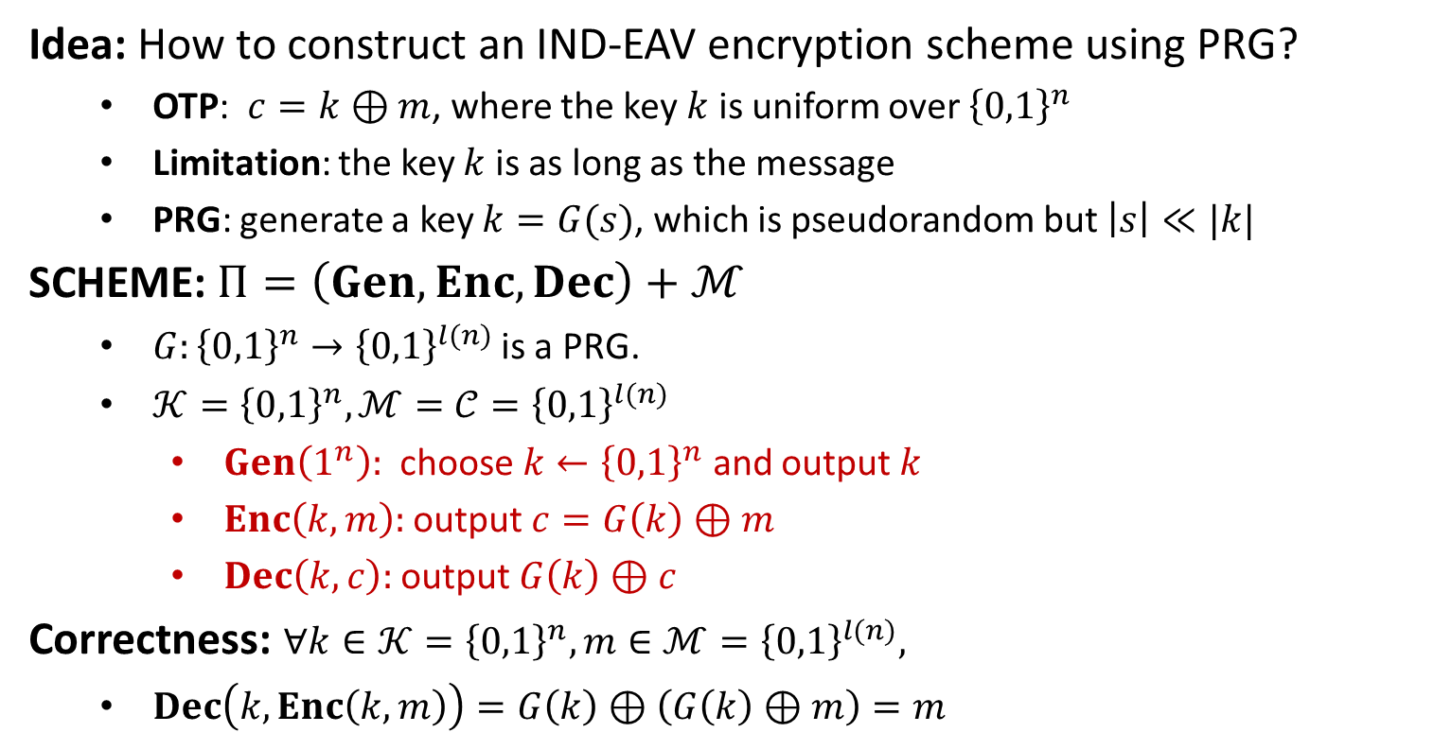
Fixed-Length Encryption from PRG
Idea: How to construct an IND-EAV encryption scheme using PRG?
OTP: $c=k⊕m$, where the key $k$ is uniform over ${\left\{0,1\right\}}^{n}$
Limitation: the key $k$ is as long as the message
PRG: generate a key $k=G(s)$, which is pseudorandom but $\left|s\right|≪|k|$
SCHEME: $Π=\left(Gen, Enc, Dec\right)+ℳ$
$G:{\left\{0,1\right\}}^{n}→{\left\{0,1\right\}}^{l(n)}$is a PRG.
$𝒦={\left\{0,1\right\}}^{n}, ℳ=𝒞={\left\{0,1\right\}}^{l(n)}$
$Gen\left(1^{n}\right):$ choose $k←{\left\{0,1\right\}}^{n}$ and output $k$
$Enc\left(k,m\right):$ output $c=G\left(k\right)⊕m$
$Dec\left(k,c\right):$ output $G\left(k\right)⊕c$
Correctness: $∀k∈𝒦={\left\{0,1\right\}}^{n}, m∈ℳ={\left\{0,1\right\}}^{l(n)},$
$Dec\left(k,Enc\left(k,m\right)\right)=G\left(k\right)⊕\left(G\left(k\right)⊕m\right)=m$

Slide 9
Fixed-Length Encryption from PRG
THEOREM: If $G$ is a PRG, then the scheme $Π$ is IND-EAV secure.
Suppose that $Π$ is not IND-EAV secure. Then $∃$ PPT adversary $𝒜$ such that
$$ε=\left|\operatorname{Pr}\left[PrivK_{𝒜, Π}^{eav}\left(n\right)=1\right] −1/2\right|$$
is non-negligible in $n$.
Without loss of generality, suppose that
$ε=\operatorname{Pr}\left[PrivK_{𝒜, Π}^{eav}\left(n\right)=1\right] −1/2$
We construct a PPT distinguisher $𝒟$ that distinguishes between $G(U_{n})$ and $U_{l(n)}$ with non-negligible probability. (gives a contradiction)
INPUT: $x∈{\left\{0,1\right\}}^{l\left(n\right)}, x←G(U_{n})$ or $x←U_{l(n)}$
$𝒟$ uses $x$ as the pad in the adversarial indistinguishability experiment
If $𝒜$’s guess $b^{′}=b$, output 1
otherwise, output 0.

Slide 10
Distinguisher $𝒟$
$$x$$
choose $m_{0}, m_{1}∈{\left\{0,1\right\}}^{l(n)}$
$$m_{0},m_{1}$$
$$b←\{0,1\}$$
$$c=x⊕m_{b}$$
$$c$$
$$b′′$$
$$b^{′}$$
$$b^{′′}=\left\{\begin{aligned}0 b^{′}≠b \\ 1 b^{′}=b\end{aligned}\right.$$
PRG Challenger
$$𝒟$$
$$𝒜$$
Experiment PRG
Experiment $E$

Slide 11
Distinguisher $𝒟$
$x←G\left(U_{n}\right):$ the experiment $E$ is $PrivK_{𝒜, Π}^{eav}\left(n\right)$
$\operatorname{Pr}\left[𝒟\left(x\right)=1\right]=\operatorname{Pr}\left[PrivK_{𝒜, Π}^{eav}\left(n\right)=1\right]=\frac{1}{2}+ε$
$x←U_{l\left(n\right)}:$ the experiment $E$ is $PrivK_{𝒜, OTP}^{eav}\left(l(n)\right)$
$\operatorname{Pr}\left[𝒟\left(x\right)=1\right]=\operatorname{Pr}\left[PrivK_{𝒜, OTP}^{eav}\left(l(n)\right)=1\right]=\frac{1}{2}$
$\left|\operatorname{Pr}\left[𝒟\left(G\left(U_{n}\right)\right)=1\right]−\operatorname{Pr}\left[𝒟\left(U_{l\left(n\right)}\right)=1\right]\right|=ε$, which is non-negligible
$G$ cannot be a PRG, contradiction.
REMARKs: Comparisons with One-Time Pad (Efficiency and Security)
Shorter secret key: encrypt $l(n)$-bit message using $n$ truly random bits
EXAMPLE: $n=128, l\left(n\right)={10}^{6}$
This is much better that OTP.
The secret key cannot be reused.
Security: IND-EAV, weaker than perfectly secret.

Slide 13



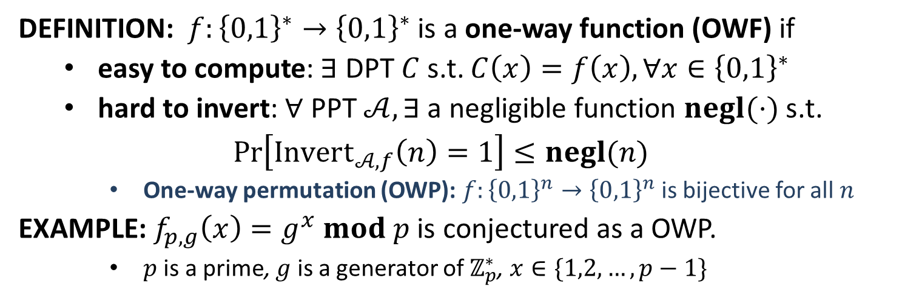




One-Way Function
The Inverting Experiment $Invert_{𝒜,f}\left(n\right)$ for $f:{\left\{0,1\right\}}^{∗}→{\left\{0,1\right\}}^{∗}$
$$x←{\left\{0,1\right\}}^{n}$$
$$y=f(x)$$
$$y$$
$$x′$$
$$Challenger$$
$$Invert_{𝒜,f}\left(n\right)=$$
$\left\{\begin{aligned}1, f\left(x^{′}\right)=y \\ 0, f\left(x^{′}\right)≠y\end{aligned}\right.$
$$Adversary 𝒜$$
DEFINITION: $f:{\left\{0,1\right\}}^{∗}→{\left\{0,1\right\}}^{∗}$ is a one-way function (OWF) if
easy to compute: $∃$ DPT $C$ s.t. $C\left(x\right)=f\left(x\right), ∀x∈{\left\{0,1\right\}}^{∗}$
hard to invert: $∀$ PPT $𝒜, ∃$a negligible function $negl(⋅)$ s.t.
$$\operatorname{Pr}\left[Invert_{𝒜,f}\left(n\right)=1\right]≤negl(n)$$
One-way permutation (OWP): $f:{\left\{0,1\right\}}^{n}→{\left\{0,1\right\}}^{n}$ is bijective for all $n$
EXAMPLE: $f_{p,g}\left(x\right)=g^{x} mod p$ is conjectured as a OWP.
$p$ is a prime, $g$ is a generator of $ℤ_{p}^{∗}$, $x∈\{1,2,…,p−1\}$

Slide 14
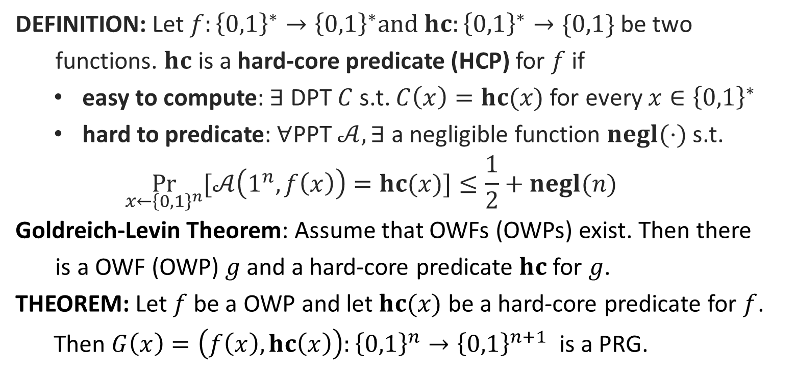
Hard-Core Predicate
DEFINITION: Let $f:{\left\{0,1\right\}}^{∗}→{\left\{0,1\right\}}^{∗}and hc:{\left\{0,1\right\}}^{∗}→\{0,1\}$ be two
functions. $hc$ is a hard-core predicate (HCP) for $f$ if
easy to compute: $∃$ DPT $C$ s.t. $C\left(x\right)=hc(x)$ for every $x∈{\left\{0,1\right\}}^{∗}$
hard to predicate: $∀$PPT $𝒜, ∃$ a negligible function $negl(⋅)$ s.t.
$$\underset{x←{\left\{0,1\right\}}^{n}}{Pr}{[𝒜\left(1^{n}, f\left(x\right)\right)=hc(x)]}≤\frac{1}{2}+negl(n)$$
Goldreich-Levin Theorem: Assume that OWFs (OWPs) exist. Then there
is a OWF (OWP) $g$ and a hard-core predicate $hc$ for $g$.
THEOREM: Let $f$ be a OWP and let $hc(x)$ be a hard-core predicate for $f$.
Then $G\left(x\right)=\left(f\left(x\right),hc\left(x\right)\right):{\left\{0,1\right\}}^{n}→{\left\{0,1\right\}}^{n+1}$ is a PRG.

Slide 15



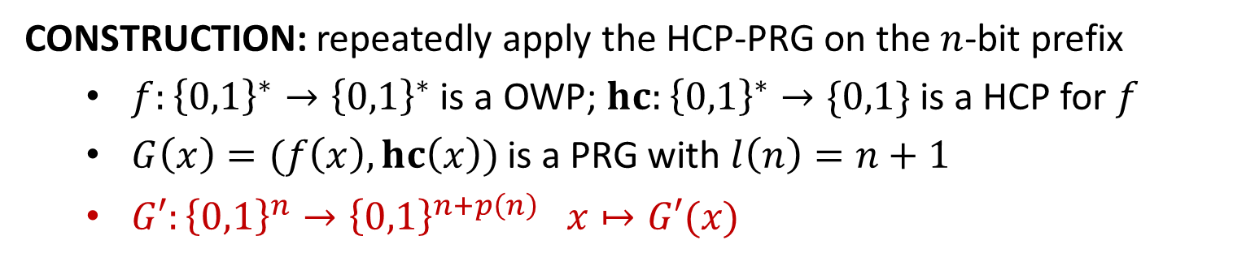
















PRG with Arbitrary Expansion
CONSTRUCTION: repeatedly apply the HCP-PRG on the $n$-bit prefix
$f:{\left\{0,1\right\}}^{∗}→{\left\{0,1\right\}}^{∗}$ is a OWP; $hc:{\left\{0,1\right\}}^{∗}→\{0,1\}$ is a HCP for $f$
$G\left(x\right)=(f\left(x\right),hc\left(x\right))$ is a PRG with $l\left(n\right)=n+1$
$G′:{\left\{0,1\right\}}^{n}→{\left\{0,1\right\}}^{n+p\left(n\right)} x↦G′(x)$
$$G′\left\{\begin{aligned} \\ \\ \\ \\ \\ \\ \\ \\ \\ \end{aligned}\right.$$
$$x$$
$$hc(x)$$
$$x$$
$$G↓$$
$$f(x)$$
$$hc(f(x))$$
$$hc(x)$$
$$G↓$$
$$f(f(x))$$
$$⋮$$
$$⋮$$
$$hc(f^{(p\left(n\right)−1)}(x))$$
$$f^{(p\left(n\right))}(x)$$
$$⋯⋯$$
$$G′(x)$$
$n$ bits
$p(n)$ bits
THEOREM: The function $G′$ is a PRG with expansion factor $n+p(n)$.

Slide 16


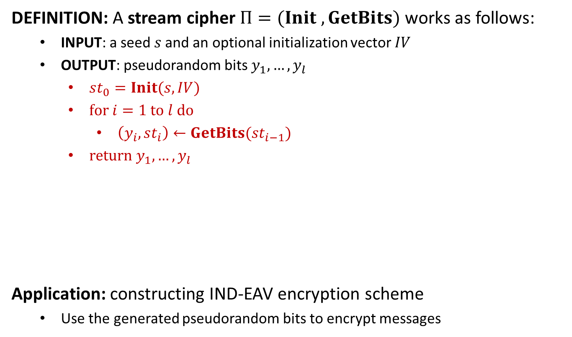











Stream Cipher
DEFINITION: A stream cipher $Π=(Init , GetBits)$ works as follows:
INPUT: a seed$s$and an optional initialization vector $IV$
OUTPUT: pseudorandom bits $y_{1},…,y_{l}$
$st_{0}=Init(s,IV)$
$for i=1 to l do$
$\left(y_{i}, st_{i}\right)←GetBits(st_{i−1})$
$return y_{1},…,y_{l}$
Application: constructing IND-EAV encryption scheme
Use the generated pseudorandom bits to encrypt messages
$$s$$
$$Init$$
$$st_{0}$$
$$GetBits$$
$$st_{1}$$
$$GetBits$$
$$st_{2}$$
$$GetBits$$
$$st_{3}$$
$$IV$$
$$⋯$$
$$y_{1}$$
$$y_{2}$$
$$y_{3}$$
$$⋯$$

